Slide 1

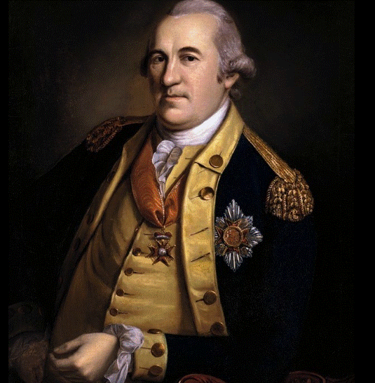
General Baron von Steuben
Life, Legacy & Role at Valley Forge
Link to Smithsonian Article https://www.smithsonianmag.com/history/underappreciated-true-story-prussian-military-office-whipped-patriots-into-shape-valley-forge-180987172/

Slide 2
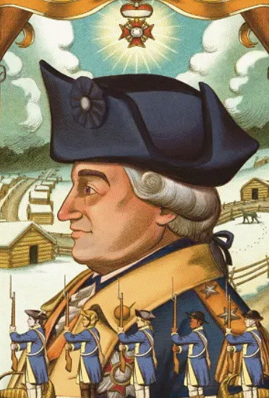
Background and Early Life
Video Link: (4 minutes)https://www.youtube.com/watch?v=Q2ZBb1a4ePo
Born September 17, 1730 in Magdeburg, Prussia;
Came from a military family.
Served as an officer in the Prussian Army under Frederick the Great during the Seven Years’ War.
After European service, he struggled financially and sought new opportunities abroad.

Slide 3
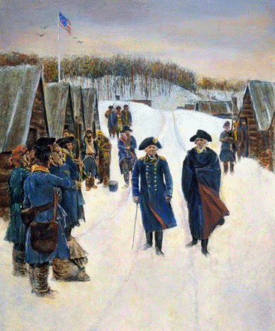
Arrival in America
Link to video: https://www.youtube.com/watch?v=1vOwQbEQFwM&t=34s
Met American agents (Franklin & Deane) in
Paris and got a letter of introduction to
Washington.
Arrived in America in December 1777 during
the Revolutionary War.
Reached Valley Forge in February 1778 amid
a struggling Continental Army.

Slide 4
Training the Troops at Valley Forge
Appointed acting Inspector General by Washington to assess the army.
Created a “model company” and drilled soldiers in discipline and battlefield skills.
Introduced European style drills, bayonet use, and camp sanitation.

Slide 5
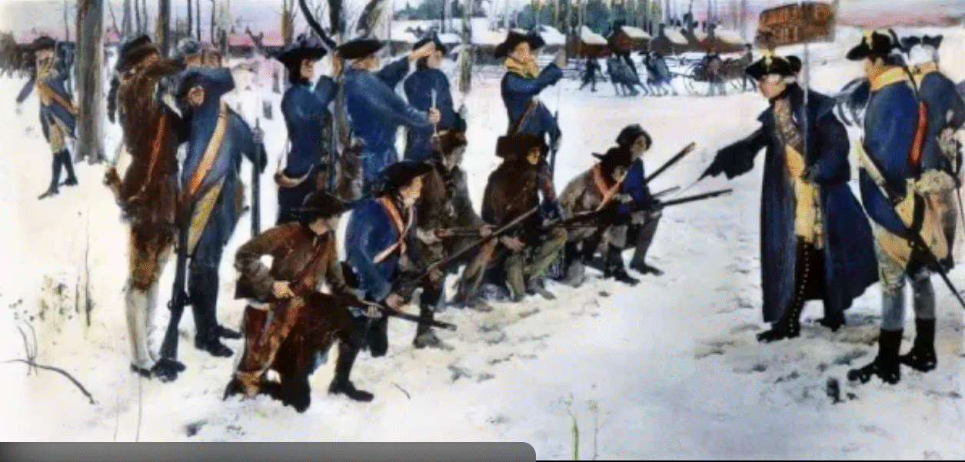
In 1778 Valley Forge , PA General Baron Friedrich von Steuben training troops.

Slide 6
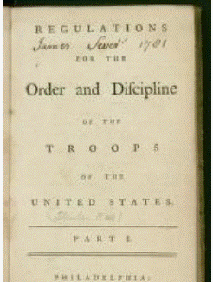
The “Blue Book”
Major Contribution and Impact on the Revolutionary War and Military
Wrote Regulations for the Order and Discipline of the Troops of the United States.
The manual became the official training guide for the U.S. Army through 1814.
Hamilton, Greene, and others helped translate and disseminate it.

Slide 7
Relationship with George Washington
Washington trusted Steuben’s military expertise and judgment.
Worked closely with Washington’s aides, like Hamilton and Greene, to implement training plans.
Steuben’s system improved Continental Army’s performance in battles like Monmouth

Slide 8
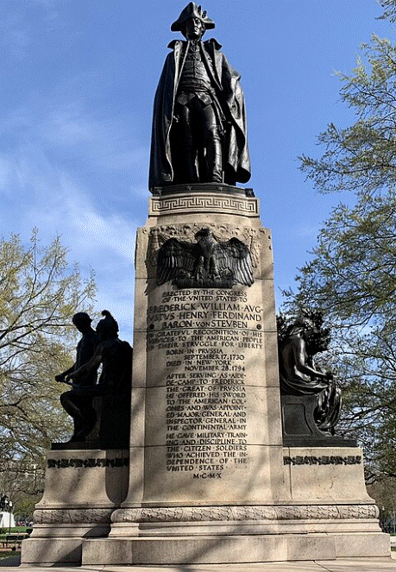

Later Life and Legacy
Served beyond Valley Forge, including at Yorktown in 1781.
After the war he lived in New York State and became a Regent; faced financial struggles but remained honored.
Remembered as the “Drillmaster” whose work shaped the early U.S. Army.
(Statue in Washington, DC)

Slide 9
Annual Celebration of General Friedrich von Steuben at Valley Forge National Park, PA
OCTOBER 11, 2026 @2pm
Celebration afterwards at the VE German Club Southampton , PA
(TICKETS and CAPACITY LIMITED for VE dinner)
2pm at Valley Forge National Park:
All area German clubs , Students of German and History or Social Studies an all schools are welcome to join in the historic fun.
We meet afterward at the VE Club in Southampton for food, singing, entertainment. TICKETS LIMITED!
All area German clubs , Students of German and History or Social Studies an all schools are welcome to join in the fun.
Please contact :
Teresa Winslow
Email: simplepureclear@gmail.com

Slide 10
SOURCES
EVERY YEAR WE CELEBRATE Baron von Steuben at his statue at Valley Forge
https://www.britannica.com/biography/Baron-von-Steuben
Encyclopaedia Britannica — Baron von Steuben
USHistory.org – Von Steuben biography
History.com – Valley Forge overview
National Park Service – Von Steuben page & videos
American Battlefield Trust biography

